Slide 1


Slide 2


Introduction to Machine Learning
Machine Learning (ML) is a branch of Artificial Intelligence (AI) that enables computers to learn from data and make decisions or predictions without being explicitly programmed.
Machine learning teaches computers to recognize patterns and make decisions automatically using data and algorithms.

Slide 3

Humans learn from past experiences
Machines follow instructions given by humans

Slide 4
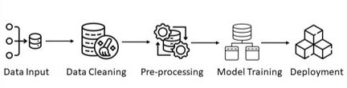
Machine Learning Workflow
Data Collection: Gathering data relevant to the problem.
Data Pre-processing: Cleaning and preparing the data for analysis (handling missing values, normalization).
Model Selection: Choosing appropriate algorithms and models.
Model Training: Using data to train the model.
Model Evaluation: Assessing model performance using metrics (accuracy, precision).
Deployment: Integrating the model into a production environment.

Slide 5
Types of Machine learning
Supervised Learning:
Training a model on labelled data-set.
Labelled data-sets have both input and output parameters.
In Supervised learning, the algorithms learn to map points between inputs and correct outputs.
Examples: Classification (spam detection), Regression (calories burnt prediction).
Unsupervised Learning:
Training a model on unlabelled data to identify patterns or structures.
The primary goal of unsupervised learning is to group or categories the unsorted dataset according to the similarities, patterns, and differences.
Machines are instructed to find the hidden patterns from the input dataset.
Examples: Clustering (customer segmentation), Association (market basket analysis)
Reinforcement Learning:
This works on a feedback based process, in which an AI agent automatically explore its surrounding by hitting and trail, taking action, learning from experiences, and improving its performance.
In this, there is no labelled data like supervised learning, and agents learn from their experiences only.
Example: Game playing (chess), Robotics.

Slide 6
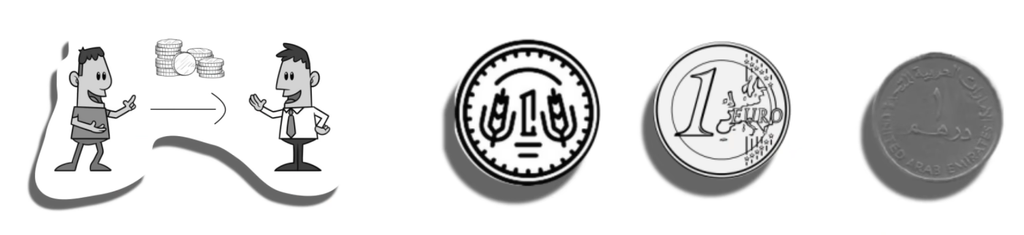
SUPERVISED LEARNING
3 GRAMS 7 GRAMS 4 GRAMS
WEIGHT = FEATURE
CURRENCY = LABEL
3 GRAMS = 1 RUPEE COIN

Slide 7
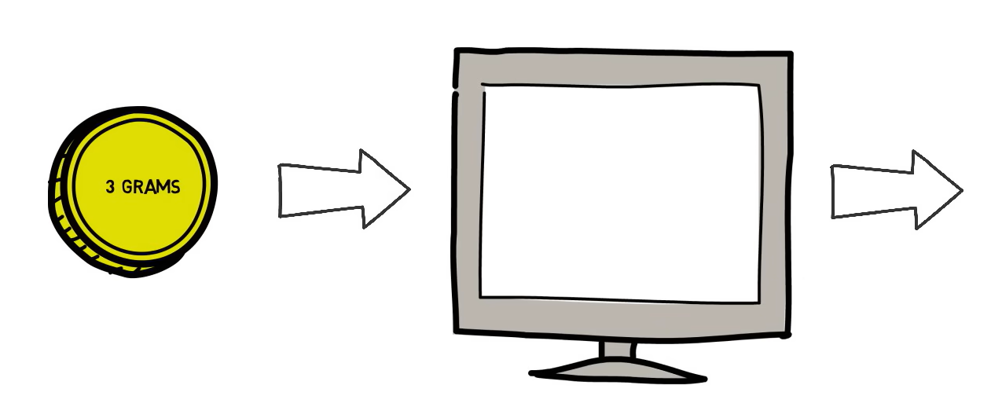
SUPERVISED LEARNING
1 RUPEE
LABELED DATA

Slide 8
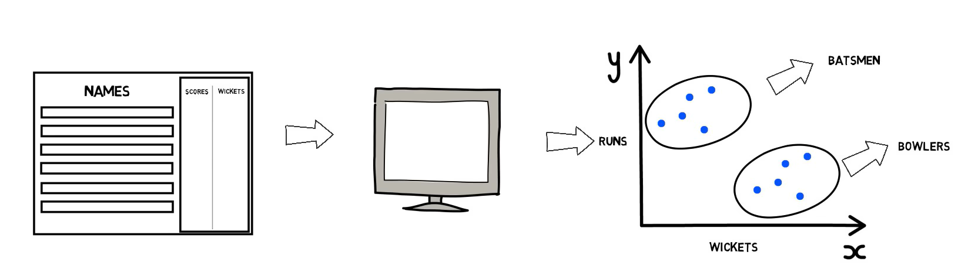
UNSUPERVISED LEARNING
NO LABELED DATA

Slide 9
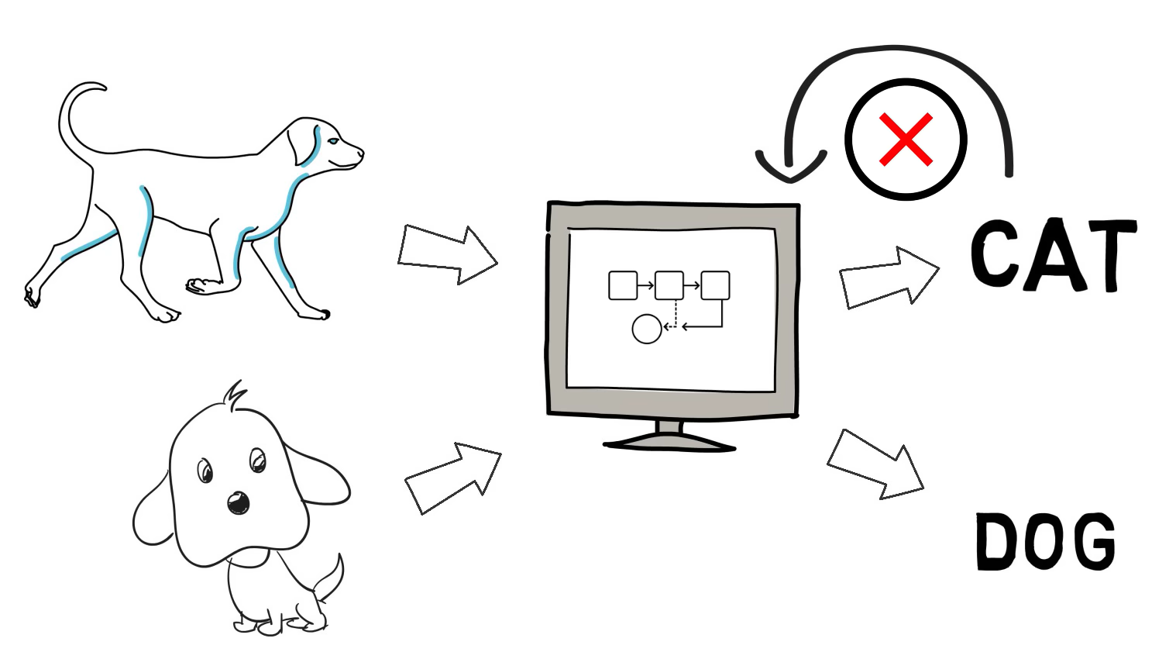
REINFORCEMENT LEARNING

Slide 10
APPLICATIONS OF MACHINE LEARNING
Healthcare
Sentiment analysis
Fraud detection
E-Commerce
Image Recognition
Speech Recognition
Self Driving Cars
Stock Market Trading
Recommender Systems
Agriculture and Crop Prediction

Slide 11
Machine Learning Module
Scikit-learn
Scikit-learn (sklearn) is a a powerful machine learning library for Python. It provides tools for classification, regression, clustering, dimensionality reduction, and model evaluation.
INSTALLATION
pip install scikit-learn

Slide 12
Supervised Learning Algorithms:
K-Nearest Neighbours (KNN)
Linear Regression
Logistic Regression
Decision Tree
Random Forest
Naïve Bayes
Support Vector Machines (SVM)
Unsupervised Learning Algorithms:
Clustering
K-Means Clustering
Dimensionality Reduction
Principle Component Analysis
Independent Component Analysis
Association Rule Learning
Apriori Algorithm

Slide 13
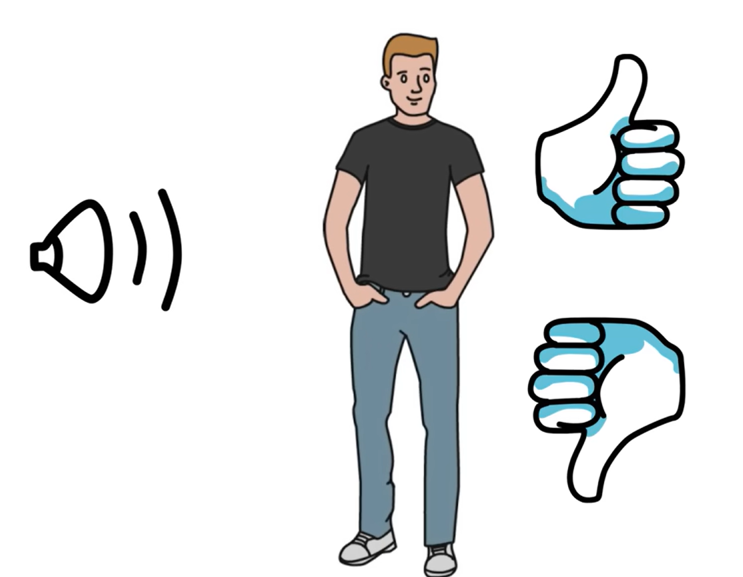
K-NEAREST NEIGHBORS (KNN)
SUPPOSE PAUL IS LISTENING TO SONGS…
TEMPO
GENRE
INTENSITY
GENDER OF VOICE

Slide 14


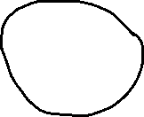

SONG A
FAST TEMPO
SOARING INTENSITY
SONG B
MEDIUM TEMPO
MEDIUM INTENSITY
LIKE
DISLIKE
Y
SOARING
A
INTENSITY
B
LIGHT
RELAXED
FAST
X
TEMPO

Slide 15
K-Nearest Neighbors (KNN) is a simple way to classify things by looking at what’s nearby.
K-Nearest Neighbors is also called as a lazy learner algorithm because it does not learn from the training set immediately instead it stores the dataset and at the time of classification it performs an action on the dataset.
Working
Step 1: Selecting the optimal value of K
K represents the number of nearest neighbors that needs to be considered while making prediction.
Step 2: Calculating distance
To measure the similarity between target and training data points Euclidean distance is used. Distance is calculated between data points in the dataset and target point.
Step 3: Finding Nearest Neighbors
The k data points with the smallest distances to the target point are nearest neighbors.
Step 4: Voting for Classification or Taking Average for Regression
When you want to classify a data point into a category (like spam or not spam), the K-NN algorithm looks at the K closest points in the dataset. These closest points are called neighbors. The algorithm then looks at which category the neighbors belong to and picks the one that appears the most. This is called majority voting.
In regression, the algorithm still looks for the K closest points. But instead of voting for a class in classification, it takes the average of the values of those K neighbors. This average is the predicted value for the new point for the algorithm.

Slide 16
Example
import pandas as pd
from sklearn.model_selection import train_test_split
from sklearn.preprocessing import LabelEncoder
from sklearn.neighbors import KNeighborsClassifier
# Load the dataset
df = pd.read_csv("iris.csv")
# Display first 5 rows
print(df.head())
print(df.describe()) # Summary statistics
print(df["species"].value_counts()) # Count of each species
# Separate features and target variable
X = df.drop(columns=["species"]) # Features (sepal/petal length & width)
y = df["species"] # Target (flower species)
# Convert species names into numerical values
le = LabelEncoder()
y = le.fit_transform(y) # Converts "setosa", "versicolor", "virginica" to 0, 1, 2

Slide 17
# Split into training (80%) and testing (20%) sets
X_train, X_test, y_train, y_test = train_test_split(X, y, test_size=0.2, random_state=42)
print(f"Training samples: {len(X_train)}, Testing samples: {len(X_test)}")
# Define KNN model with k=5
knn = KNeighborsClassifier(n_neighbors=5)
# Train the model
knn.fit(X_train, y_train)
# Predict the test set
y_pred = knn.predict(X_test)
from sklearn.metrics import accuracy_score, classification_report, confusion_matrix
# Calculate accuracy
accuracy = accuracy_score(y_test, y_pred)
print(f"Accuracy: {accuracy * 100:.2f}%")
# Classification report
print("\nClassification Report:")
print(classification_report(y_test, y_pred, target_names=le.classes_))
# Confusion matrix
print("\nConfusion Matrix:")
print(confusion_matrix(y_test, y_pred))

Slide 18


MODEL EVALUATION
Classification Metrics
Classification metrics are used to evaluate the performance of a classification model. These metrics help determine how well a model distinguishes between different classes.
Accuracy - Measures the percentage of correctly classified instances.
Best for: Balanced datasets where classes have nearly equal distribution.
Precision (Positive Predictive Value) - Measures how many of the predicted positive cases are actually positive.
Best for: When false positives (FP) are costly (e.g., medical tests, spam detection).

Slide 19


Recall - Measures how many actual positive cases were correctly predicted.
Best for: When false negatives (FN) are costly (e.g., fraud detection, disease diagnosis).
F1-Score – Harmonic mean of precision and recall, balancing both.
Best for: When both false positives and false negatives matter.

Slide 20
Confusion Matrix
Actual \ Predicted | Positive (P) | Negative (N)
Positive ( P) | TP | FN
Negative (N) | FP | TN
True Positive (TP): Correctly predicted positive cases.
False Positive (FP): Incorrectly predicted as positive.
False Negative (FN): Incorrectly predicted as negative.
True Negative (TN): Correctly predicted negative cases.

Slide 21
Label Encoder
Label Encoding is a technique used in machine learning to convert categorical data (text labels) into numerical values so that models can process them.
Why we use Label Encoding?
Many machine learning models like decision trees work with numbers, not text.
Converts text data into a form that the model understands.
Reduces memory usage compared to text data.

Slide 22
Example
from sklearn.preprocessing import LabelEncoder
# Sample categorical data
colors = ['Red', 'Green', 'Blue', 'Green', 'Red', 'Blue']
# Initialize LabelEncoder
encoder = LabelEncoder()
# Fit and transform the data
encoded_colors = encoder.fit_transform(colors)
print("Original:", colors)
print("Encoded:", encoded_colors)
Output
Original: ['Red', 'Green', 'Blue', 'Green', 'Red', 'Blue’]
Encoded: [2 1 0 1 2 0]

Slide 23
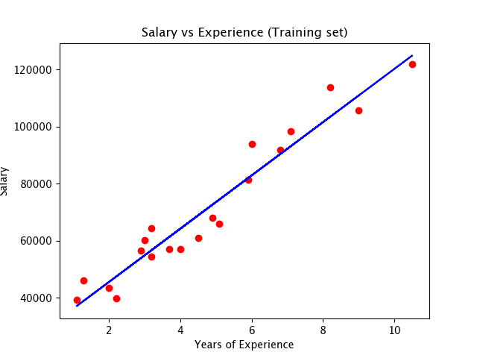
Dependent and Independent Variables
Independent variables: Also called inputs or predictors, do not depend on other features of interest.
Example: Years of Experience
Dependent variables: Also called outputs or responses, depend on the independent variables.
Example: Salary

Slide 24
LINEAR REGRESSION
Linear Regression is one of the most simple Machine Learning algorithm which is used for solving regression problems.
It is used for predicting the continuous dependent variable with the help of independent variables and relationship between them.
The goal of the Linear regression is to find the best fit line that can accurately predict the output.
The relationship should be of linear nature.
The output for Linear regression should only be the continuous values such as price, age, salary, etc.

Slide 25
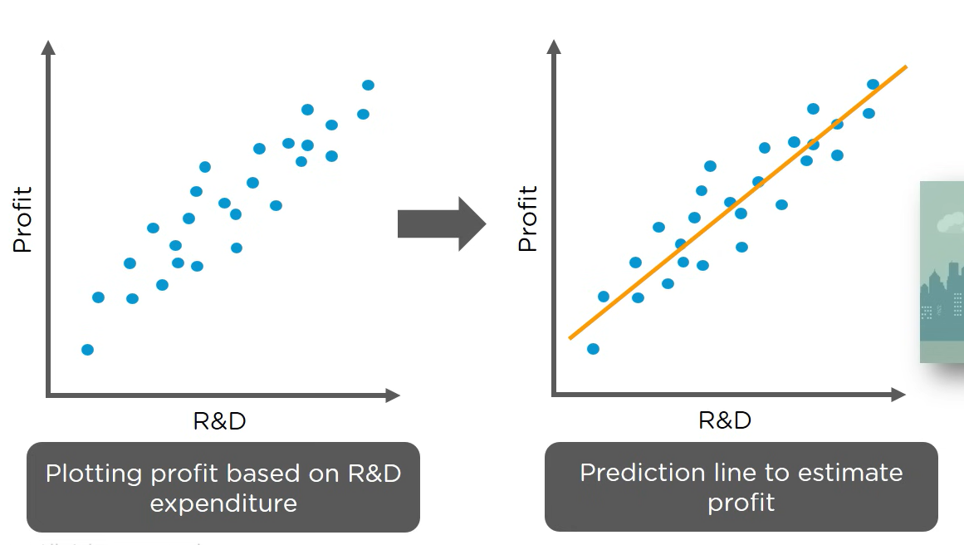

Slide 26
Working
Data with Two variables – You have two variables, such as X (Independent variable) and Y (Dependent variable). The goal of linear regression is to find the best line that fits these points so that you can use it to predict future values of Y.
Fitting a Line – Linear regression looks for the line that best fits the data points. The equation of the line is
Y = mX + b
* m is the slope of the line.
* b is the y-intercept.
* X is the input, and Y is the predicted output
The algorithm works to find the best values for m and b so that the line is as close as possible to all the data points.
Making predictions – Once you have your best-fit line, you can use it to predict the value of Y for any given X

Slide 27
Example
import numpy as np
import pandas as pd
from sklearn.linear_model import LinearRegression
from sklearn.model_selection import train_test_split
data = pd.read_csv(“Housing.csv”)
data = data.dropna()
data = data.replace([‘yes’, ‘no’, ‘furnished’, ‘semi-furnished’, ‘unfurnished’], [True, False, 1, 0.5, 0]
print(data.head())
y = data[‘price’]
print(y.head())
x = data.drop([‘price’], axis = 1)
print(x.columns)
x_train, x_test, y_train, y_test = train_test_split(x, y, test_size = 0.2)
model = LinearRegression()
model.fit(x_train, y_train)
results = model.predict(x_test)

Slide 28
LOGISTIC REGRESSION
Logistic regression is one of the most popular Machine Learning Algorithm which is used for solving classification problems.
Logistic regression is used to predict the categorical variable with the help of independent variables.
The output of Logistic Regression problem can be only between 0 and 1.
Logistic regression can be used where the probabilities between two classes is required, such as whether it will rain today or not, either 0 or 1, true or false, etc.
Logistic regression is based on the concept of Maximum Likelihood estimation.

Slide 29
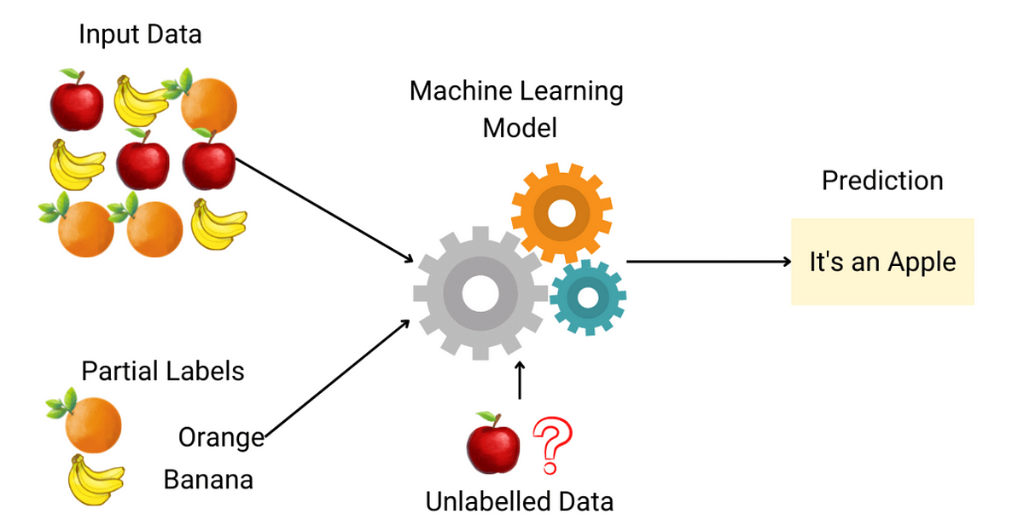

Slide 30
Working
Linear Combination of Inputs – Logistic regression starts like Linear regression. It takes the input features and combines them using a weighted sum, similar to how linear regression finds a straight line. The equation looks like this:
z = mX + b
* X is the input data.
* m is the weight (slope)
* b is the intercept
* z is the result of this linear combination

Slide 31

Sigmoid Function – Logistic Regression applies a sigmoid function to the result (z) of the linear combination. The sigmoid function squashes any real number into a value between 0 and 1. The sigmoid function looks like this:
The result of this function is a probability between 0 and 1, which tells you how likely it is that an event will occur.
* If the result is closer to 1: The event is more likely to happen.
* If the result is closer to 0: The event is less likely to happen.
Making Decision – Based on the probability from the sigmoid function, logistic regression then makes a decision:
* If the probability is above a threshold(usually 0.5), it classifies the input as class 1.
* If the probability is below the threshold, it classifies the input as class 0.

Slide 32
Example
import pandas as pd
from sklearn.model_selection import train_test_split
from sklearn.preprocessing import LabelEncoder
# Load the dataset from CSV
df = pd.read_csv("iris.csv")
# Display first 5 rows
print(df.head())
# Separate features and target variable
X = df.drop(columns=["species"]) # Features (sepal/petal length & width)
y = df["species"] # Target (flower species)
# Convert categorical species column to numeric
le = LabelEncoder()
y = le.fit_transform(y) # Converts "setosa", "versicolor", "virginica" to 0, 1, 2
# Split into training (80%) and testing (20%) sets
X_train, X_test, y_train, y_test = train_test_split(X, y, test_size=0.2, random_state=42)

Slide 33
from sklearn.linear_model import LogisticRegression
# Initialize Logistic Regression model
model = LogisticRegression(max_iter=200)
# Train the model
model.fit(X_train, y_train)
# Make predictions
y_pred = model.predict(X_test)

Slide 34


Regression Metrics
Regression metrics help evaluate how well a regression model predicts continuous values. These metrics measure the error between actual and predicted values.
Mean Squared Error (MSE) - Measures the average squared difference between actual and predicted values.
Interpretation: Larger errors are penalized more due to squaring.
Best for: When larger error need to be heavily penalized.
Mean Absolute Error (MAE) - Measures the average absolute difference between actual and predicted values.
Interpretation: Lower MAE means better performance.
Best for: When all errors are equally important.

Slide 35


Root Mean Squared Error (RMSE) – Square root of MSE, bringing error back to original units.
Interpretation: Lower RMSE means better performance.
Best for: When large errors should be penalized but still interpretable.
R-Squared – Coefficient of Determination – Measures how well independent variables explain the variance in the dependent variable.
where:
* SSres = Sum of squared residuals
* SStot = Total sum of squares
Interpretation:
R-square = 1 → Perfect model
R-square = 0 → Model explains nothing
R-square < 0 → Worse than just predicting the mean
Best for: Checking how well the model fits the data.

Slide 36
DECISION TREE ALGORITHM
Decision tree is a supervised learning technique that can be used for both classification and regression problems, but mostly it is preferred for solving classification problems.
Working
Start with a Question (Root Node) – The tree starts with a big question. This is the root node, the starting point of the tree.
Split based on Answers (Branches and Nodes) – Each question has yes/no (true/false) answers or multiple choices. Based on the answer, the decision moves to the next question (a node). This process continues, splitting the data at each step.
Continue splitting until a Final decision is reached (Leaf Node) – The tree keeps asking questions until it reaches a final decision (a leaf node). This could be a classification.

Slide 37
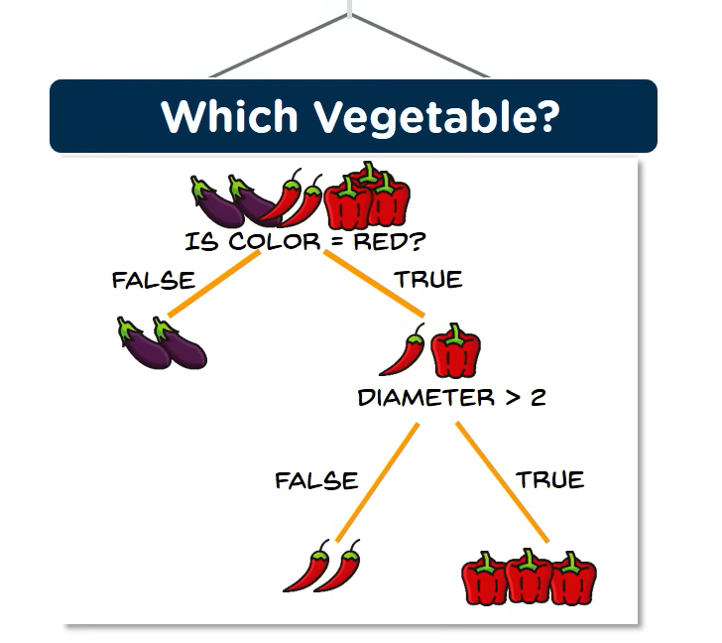

Slide 38
Terminologies
Root node: Root node is from where the decision tree starts.it represents the entire dataset, which further gets divided into two or more subsets.
Leaf node: Leaf nodes are the final output node, and the tree cannot be segregated further after getting a leaf node.
Decision nodes: Decision nodes are used to make any decision and have multiple branches.
Branch/ sub tree: A tree formed by splitting the tree.
Pruning: Pruning is the process of removing the unwanted branches from the tree.
Parent/ Child node: The root node of the tree is called the parent node, and the other nodes are called the child nodes.

Slide 39
Example
import pandas as pd
from sklearn.model_selection import train_test_split
from sklearn.preprocessing import LabelEncoder
# Load the dataset from CSV
df = pd.read_csv("iris.csv")
# Display first 5 rows
print(df.head())
# Separate features and target variable
X = df.drop(columns=["species"]) # Features (sepal/petal length & width)
y = df["species"] # Target (flower species)
# Convert categorical species column to numeric
le = LabelEncoder()
y = le.fit_transform(y) # Converts "setosa", "versicolor", "virginica" to 0, 1, 2
# Split into training (80%) and testing (20%) sets
X_train, X_test, y_train, y_test = train_test_split(X, y, test_size=0.2, random_state=42)

Slide 40
from sklearn.tree import DecisionTreeClassifier
# Initialize Decision Tree model
model = DecisionTreeClassifier(criterion="gini", max_depth=3, random_state=42)
# Train the model
model.fit(X_train, y_train)
# Make predictions
y_pred = model.predict(X_test)

Slide 41
RANDOM FOREST REGRESSION
A Random Forest is like a team of decision trees working together to make a better prediction. Instead of using just one decision tree, it uses many trees and takes an average result.
The Decision of the majority of the trees is chosen by the random forest as the final decision.
It is used when we want to predict a continuous number.

Slide 42
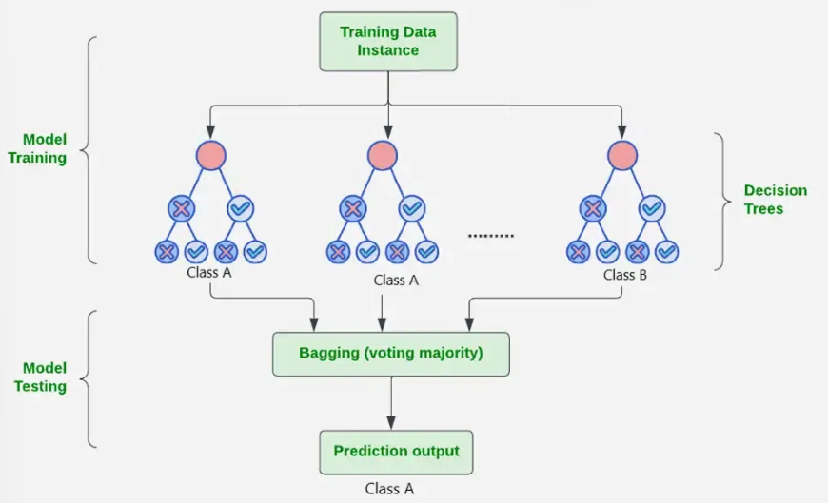

Slide 43
Example
import pandas as pd
from sklearn.model_selection import train_test_split
from sklearn.preprocessing import LabelEncoder
# Load the dataset from CSV
df = pd.read_csv("iris.csv")
# Display first 5 rows
print(df.head())
# Separate features and target variable
X = df.drop(columns=["species"]) # Features (sepal/petal length & width)
y = df["species"] # Target (flower species)
# Convert categorical species column to numeric
le = LabelEncoder()
y = le.fit_transform(y) # Converts "setosa", "versicolor", "virginica" to 0, 1, 2
# Split into training (80%) and testing (20%) sets
X_train, X_test, y_train, y_test = train_test_split(X, y, test_size=0.2, random_state=42)

Slide 44
from sklearn.ensemble import RandomForestClassifier
# Initialize Random Forest model with 100 trees
model = RandomForestClassifier(n_estimators=100, criterion="gini", random_state=42)
# Train the model
model.fit(X_train, y_train)
# Make predictions
y_pred = model.predict(X_test)

Slide 45
NAIVE BAYES ALGORITHM
Naïve Bayes classifiers are used for classification tasks, works on the principles of conditional probability as given by the Bayes theorem.
Bayes Theorem
P(A|B) = [P(B|A)P(A)] / P(B)
where:
P(A|B) = Conditional Probability of A given B
P(B|A) = Conditional Probability of B given A
P(A) = Probability of event A
P(B) = Probability of event B

Slide 46
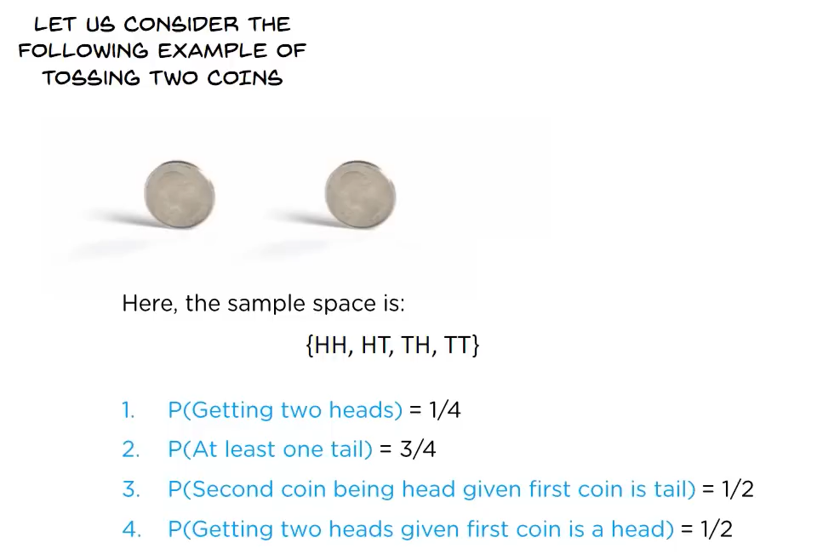

Slide 47
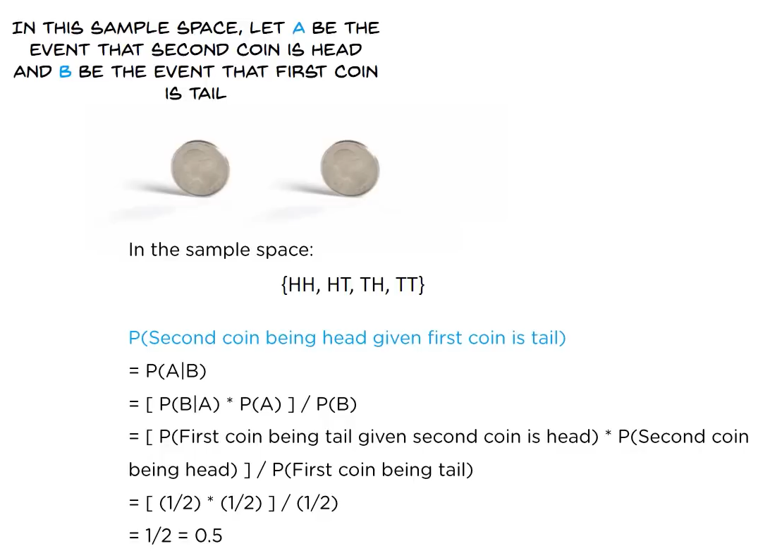

Slide 48
Working
Prepare the data – Collect labelled data and extract features.
Calculate Probabilities using Bayes’ Theorem – Compute prior probabilities (how often each class appears). Compute likelihood probabilities (how often features appear in each class)
Make predictions – For a new data point, calculate the probability for each class. Choose the class with the highest probability.
Evaluate the Model – Measure accuracy using test data. Improve performance by tuning features or handling missing data.

Slide 49
Uses of Naïve Bayes:
Face Recognition
Weather Prediction
Medical Diagnosis
News Classification

Slide 50
Example
import pandas as pd
from sklearn.model_selection import train_test_split
from sklearn.preprocessing import LabelEncoder
# Load the dataset from CSV
df = pd.read_csv("iris.csv")
# Display first 5 rows
print(df.head())
# Separate features and target variable
X = df.drop(columns=["species"]) # Features (sepal/petal length & width)
y = df["species"] # Target (flower species)
# Convert categorical species column to numeric
le = LabelEncoder()
y = le.fit_transform(y) # Converts "setosa", "versicolor", "virginica" to 0, 1, 2
# Split into training (80%) and testing (20%) sets
X_train, X_test, y_train, y_test = train_test_split(X, y, test_size=0.2, random_state=42)

Slide 51
from sklearn.naive_bayes import GaussianNB
from sklearn.metrics import accuracy_score, classification_report, confusion_matrix
# Initialize Naïve Bayes model
model = GaussianNB()
# Train the model
model.fit(X_train, y_train)
# Make predictions
y_pred = model.predict(X_test)
# Calculate accuracy
accuracy = accuracy_score(y_test, y_pred)
print(f"Accuracy: {accuracy * 100:.2f}%")
# Classification report
print("\nClassification Report:")
print(classification_report(y_test, y_pred, target_names=le.classes_))
# Confusion matrix
print("\nConfusion Matrix:")
print(confusion_matrix(y_test, y_pred))

Slide 52
SUPPORT VECTOR MACHINE (SVM)
SVM is used for classification and regression tasks, but it is mostly used for classification.
Working
Separating Data with a Line (or Hyperplane) – If you have two types of points on a 2D graph, representing two different categories. SVM tries to draw a straight line (or a hyperplane in higher dimensions) that best separates these two groups.
Finding the Best Line (Maximum Margin) – Among all possible lines that separate the points, SVM chooses the one that maximizes the margin, meaning it keeps the farthest possible distance from the nearest points of both categories. These closest points are called support vectors. Sometimes, the data is not neatly separable with a straight line. In such cases, SVM uses a technique called the Kernel Trick, which transforms the data into a higher dimension where a separation is possible.
Making Predictions – Once the best boundary (hyperplane) is found, new data points can be classified by checking which side of the boundary they fall on.

Slide 53
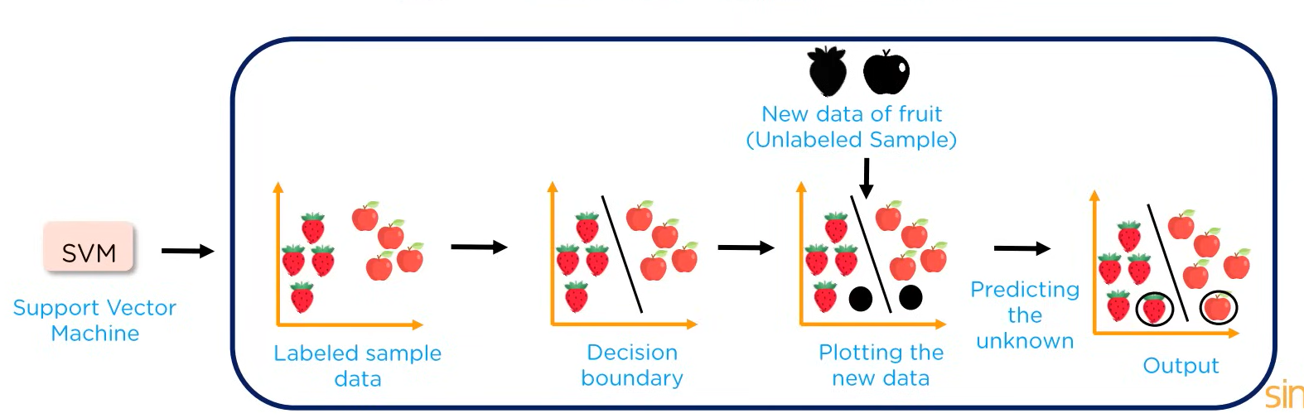

Slide 54
Applications
Face detection
Text categorization
Bioinformatics
SVM Components
Support Vectors: Data points closest to the hyperplane that influence its position.
Hyperplane: A decision boundary that separates different classes in feature space.
Margin: The distance between the hyperplane and the nearest data point from either class.

Slide 55
Example
import pandas as pd
from sklearn.model_selection import train_test_split
from sklearn.preprocessing import LabelEncoder
# Load the dataset from CSV
df = pd.read_csv("iris.csv")
# Display first 5 rows
print(df.head())
# Separate features and target variable
X = df.drop(columns=["species"]) # Features (sepal/petal length & width)
y = df["species"] # Target (flower species)
# Convert categorical species column to numeric
le = LabelEncoder()
y = le.fit_transform(y) # Converts "setosa", "versicolor", "virginica" to 0, 1, 2
# Split into training (80%) and testing (20%) sets
X_train, X_test, y_train, y_test = train_test_split(X, y, test_size=0.2, random_state=42)

Slide 56
from sklearn.svm import SVC
from sklearn.metrics import accuracy_score, classification_report, confusion_matrix
# Initialize SVM model with linear kernel
model = SVC(kernel="linear", C=1.0, random_state=42)
# Train the model
model.fit(X_train, y_train)
# Make predictions
y_pred = model.predict(X_test)
# Calculate accuracy
accuracy = accuracy_score(y_test, y_pred)
print(f"Accuracy: {accuracy * 100:.2f}%")
# Classification report
print("\nClassification Report:")
print(classification_report(y_test, y_pred, target_names=le.classes_))
# Confusion matrix
print("\nConfusion Matrix:")
print(confusion_matrix(y_test, y_pred))

Slide 57
Introduction to Text Mining
Text Mining (also called Text Analytics) is the process of extracting meaningful information from unstructured text data.
It helps in transforming a raw text into structured data for analysis, insights, and decision making.
Flow of Text Mining
Text Preprocessing
Feature Extraction
Text Analysis
Text Classification & Clustering
Visualization
Interpretation

Slide 58

TF-IDF (Term Frequency – Inverse Document Frequency)
TF-IDF is a numerical statistic used in text mining to measure how important a word is in a document relative to a collection of documents.
It helps in identifying significant words while reducing the weight of commonly used words like “the”, “is”, “and”, etc.
Working
TF-IDF is a combination of two components:
Term Frequency (TF): Measure how often a word appears in a document.
Higher TF means the word appears frequently in the document.

Slide 59

Inverse Document Frequency (IDF): Measures how important a word is by reducing the weight of common words.
Words that appear in many documents get a low IDF (less important).
Rare words get a high IDF (more important).
TF-IDF Score:
TF-IDF = TF x IDF
High TF-IDF score: Important and unique word in the document.
Low TF-IDF score: Common and less significant word.

Slide 60
Example
from sklearn.feature_extraction.text import TfidfVectorizer
# Sample text documents
documents = [
"The cat sat on the mat.",
"The dog sat on the mat.",
"The cat and dog are friends."
]
# Create TF-IDF Vectorizer
vectorizer = TfidfVectorizer()
# Compute TF-IDF scores
tfidf_matrix = vectorizer.fit_transform(documents)
# Get feature names (words)
feature_names = vectorizer.get_feature_names_out()
# Convert to DataFrame for better readability
import pandas as pd
df = pd.DataFrame(tfidf_matrix.toarray(), columns=feature_names)
# Display the TF-IDF scores
print(df)

Slide 61
UNSUPERVISED MACHINE LEARNING ALGORITHMS
CLUSTERING ALGORITHM
K MEANS CLUSTERING
K Means clustering is an unsupervised learning algorithm which groups the unlabeled dataset into different cluster.
The algorithm operates iteratively, minimizing the variance within each cluster.
Working
You have a Bunch of Dots – Suppose you have a lot of data points (dots) on a graph, and you want to divide them into groups based on how close they are to each other.
Pick Random Centers (K Centers) - You first decide how many groups (clusters) you want, let's say 3. The algorithm randomly selects 3 points (centroids) as the starting "centers" of these groups.
Assign each dot to the nearest center - Every data point is assigned to the closest center, forming 3 clusters.
Move the Centers - The center of each cluster is then moved to the average position of all the points in that cluster.
Repeat until it Settles - Steps 3 and 4 are repeated until the centers stop changing much. This means the clusters are now stable.

Slide 62
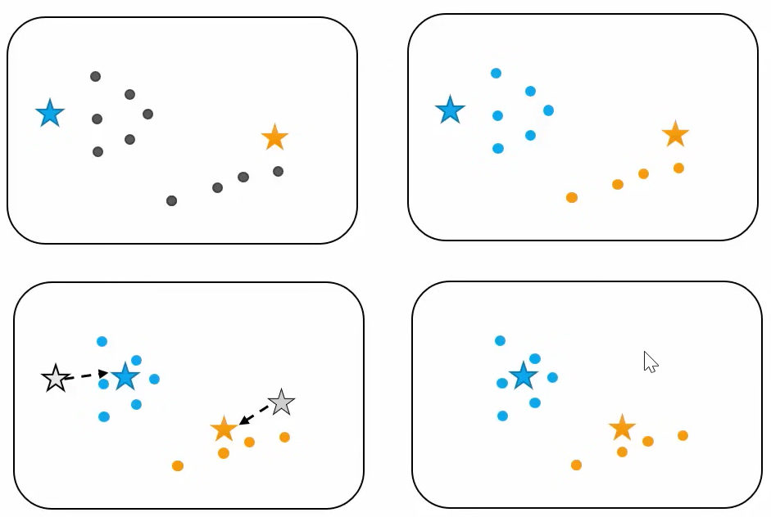
Pick Random Centers

Slide 63
Example
import numpy as np
import matplotlib.pyplot as plt
from sklearn.datasets import make_blobs
from sklearn.cluster import KMeans
# Generate synthetic dataset with 4 clusters
X, y_true = make_blobs(n_samples=300, centers=4, cluster_std=1.0, random_state=42)
# Plot the dataset
plt.figure(figsize=(8, 6))
plt.scatter(X[:, 0], X[:, 1], s=50, alpha=0.7)
plt.xlabel("Feature 1")
plt.ylabel("Feature 2")
plt.title("Generated Cluster Dataset")
plt.show()
# Define K-Means with 4 clusters
kmeans = KMeans(n_clusters=4, random_state=42, n_init=10)
# Train model
kmeans.fit(X)
# Get cluster labels
clusters = kmeans.labels_

Slide 64
plt.figure(figsize=(8, 6))
# Plot the clustered data
plt.scatter(X[:, 0], X[:, 1], c=clusters, cmap="viridis", s=50, alpha=0.7)
# Plot cluster centers
centers = kmeans.cluster_centers_
plt.scatter(centers[:, 0], centers[:, 1], c="red", marker="X", s=200, label="Centroids")
plt.xlabel("Feature 1")
plt.ylabel("Feature 2")
plt.title("K-Means Clustering on Synthetic Data")
plt.legend()
plt.show()

Slide 65
DIMENSIONALITY REDUCTION
PRINCIPLE COMPONENT ANALYSIS
Imagine you have a large table with lots of columns (features), but you want to simplify the data while keeping the most important information. PCA helps by reducing the number of columns while still capturing the key patterns in the data.
Working
Start with data - You have a dataset with many features (e.g., height, weight, age, income, etc.).
Standardization - Since features may have different scales (e.g., weight in kg vs. income in dollars), PCA first standardizes them to have the same scale.
Find New Axes - PCA looks for new directions (called principal components) that best capture the variation in the data. These are like new "super features" that combine information from multiple original features.
Rank the Components - It ranks these new features based on how much information (variance) they capture.
Select Top Components - Instead of keeping all original features, you pick the top few principal components that explain most of the data’s variation.
Transform the Data - The data is now represented in terms of these fewer components, making it simpler and easier to analyze.

Slide 66
Example
import numpy as np
import matplotlib.pyplot as plt
import seaborn as sns
from sklearn.datasets import make_blobs
from sklearn.decomposition import PCA
# Generate synthetic dataset with 6 features and 4 clusters
X, y = make_blobs(n_samples=300, centers=4, n_features=6, random_state=42)
# Print dataset shape
print(f"Original dataset shape: {X.shape}") # (300 samples, 6 features)
# Reduce dimensions from 6 to 2
pca = PCA(n_components=2)
X_pca = pca.fit_transform(X)
# Print transformed dataset shape
print(f"Transformed dataset shape: {X_pca.shape}") # (300 samples, 2 features)

Slide 67
# Scatter plot of PCA-transformed data
plt.figure(figsize=(8, 6))
sns.scatterplot(x=X_pca[:, 0], y=X_pca[:, 1], hue=y, palette="coolwarm", alpha=0.7)
plt.title("PCA on Unsupervised Dataset")
plt.xlabel("Principal Component 1")
plt.ylabel("Principal Component 2")
plt.show()
# Print explained variance ratio
explained_variance = pca.explained_variance_ratio_
print(f"Explained Variance: {explained_variance * 100}")
# Plot explained variance
plt.figure(figsize=(8, 5))
plt.bar(range(1, len(explained_variance) + 1), explained_variance * 100, alpha=0.7, color="blue")
plt.xlabel("Principal Components")
plt.ylabel("Explained Variance (%)")
plt.title("Explained Variance by PCA Components")
plt.show()

Slide 68
INDEPENDENT COMPONENT ANALYSIS (ICA)
Independent Component Analysis is a technique used to separate mixed signals into their independent sources.
The application of ICA ranges from audio and image processing to biomedical signal analysis. The article discusses about the fundamentals of ICA.
Working
Data Collection – You collect the mixed signals. For example, the sound recordings from multiple microphones.
Assumption of Independence – ICA assumes that the underlying sources (like the songs) are independent of each other.
Transformation – It finds a transformation matrix that separates the mixed signals into their independent components (the original signals).
Output – The algorithm outputs the independent components. These are the sources that caused the mixture (e.g. the songs).

Slide 69
Example
import numpy as np
import matplotlib.pyplot as plt
from sklearn.decomposition import FastICA
from sklearn.datasets import make_blobs
# Step 1: Generate two independent sources (clusters)
n_samples = 2000
X, _ = make_blobs(n_samples=n_samples, centers=2, random_state=42)
# Step 2: Create a random mixing matrix
A = np.array([[1, 1], [0.5, 2]]) # Mixing matrix
# Step 3: Mix the signals (create the mixed data)
X_mixed = np.dot(X, A.T) # Mix the sources
# Step 4: Apply ICA to recover the original sources
ica = FastICA(n_components=2)
X_ica = ica.fit_transform(X_mixed) # Recover the sources

Slide 70
# Step 5: Plot the results
plt.figure(figsize=(8, 6))
# Plot the mixed signals (observed data)
plt.subplot(3, 1, 1)
plt.title('Mixed Signals')
plt.plot(X_mixed[:100]) # Show first 100 samples
plt.xlabel('Samples')
plt.ylabel('Mixed Signals')
# Plot the recovered signals (after ICA)
plt.subplot(3, 1, 2)
plt.title('Recovered Sources by ICA')
plt.plot(X_ica[:100]) # Show first 100 samples
plt.xlabel('Samples')
plt.ylabel('Independent Components')
# Plot the original sources (true components)
plt.subplot(3, 1, 3)
plt.title('Original Sources')
plt.plot(X[:100]) # Show first 100 samples
plt.xlabel('Samples')
plt.ylabel('Original Sources')
plt.tight_layout()
plt.show()

Slide 71
ASSOCIATION RULE LEARNING
APRIORI ALGORITHM
The Apriori Algorithm is a popular algorithm used in data mining to find frequent itemsets in a dataset and to discover association rules.
It is mainly used for market basket analysis to find patterns like "customers who buy bread are also likely to buy butter.“
In simple words:
Apriori helps in finding associations between items in large datasets, such as products often bought together.
It works by looking for patterns that appear frequently in the data and uses them to make predictions about what items are likely to be purchased together.

Slide 72


Example
Create a List of Items:
Think of a store's transactions as a list of items purchased together. For example:
Transaction 1: [Bread, Butter]
Transaction 2: [Bread, Milk]
Transaction 3: [Butter, Milk]
Transaction 4: [Bread, Butter, Milk]
Support of an itemset is the proportion of transactions that contain that itemset. It is calculated as:
Confidence of a rule tells us how likely it is that the second item is purchased when the first item is purchased. It is calculated as:

Slide 73
Step 1: Generate Candidate Itemsets (C1):
C1: {Bread}, {Butter}, {Milk}
Step 2: Calculate Support for C1:
Support({Bread}) = 3/4 = 0.75
Support({Butter}) = 3/4 = 0.75
Support({Milk}) = 3/4 = 0.75
Step 3: Generate Candidate Itemsets (C2):
C2: {Bread, Butter}, {Bread, Milk}, {Butter, Milk}
Step 4: Calculate Support for C2:
Support({Bread, Butter}) = 3/4 = 0.75
Support({Bread, Milk}) = 2/4 = 0.50
Support({Butter, Milk}) = 2/4 = 0.50
Step 5: Generate Rules:
{Bread} → {Butter} with confidence = 0.75 / 0.75 = 1.00 (valid rule)
{Bread} → {Milk} with confidence = 0.50 / 0.75 = 0.67 (valid rule)
{Butter} → {Milk} with confidence = 0.50 / 0.75 = 0.67 (valid rule)

Slide 74
Example
pip install mlxtend
import pandas as pd
from mlxtend.frequent_patterns import apriori, association_rules
# Sample Retail Transaction Dataset (for demonstration purposes)
data = {
'Milk': [1, 1, 0, 1, 0],
'Bread': [1, 1, 1, 1, 1],
'Butter': [1, 0, 1, 1, 0],
'Beer': [0, 1, 1, 1, 1],
'Diaper': [1, 0, 1, 0, 1]
}
# Create a DataFrame
df = pd.DataFrame(data)
# Apply the Apriori Algorithm to find frequent itemsets with a minimum support of 0.6
frequent_itemsets = apriori(df, min_support=0.6, use_colnames=True)

Slide 75
# Print the frequent itemsets
print("Frequent Itemsets:")
print(frequent_itemsets)
# Generate association rules from the frequent itemsets with a minimum lift of 1
rules = association_rules(frequent_itemsets, metric="lift", min_threshold=1.0)
# Print the association rules
print("\nAssociation Rules:")
print(rules)

